Slide 1

Introduction To ECS
Made by Amr Ibrahim

Slide 2
Table of Contents
What is ECS
Working with AWS ECS
ECS Task
ECS services
ECS infrastructure and launch

Slide 3
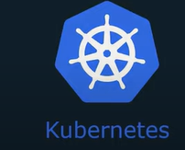
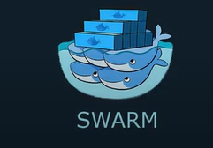
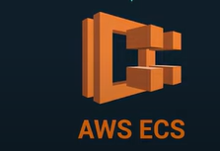
What is ECS
ECS is managed container orchestrator

Slide 4
Why orchestrators
Manage lifecycle of containers create/restart/destroy
Deploy & load-balance application across multiple servers
Autoscaling to handle variance in traffic
Rolling out changes to application

Slide 5
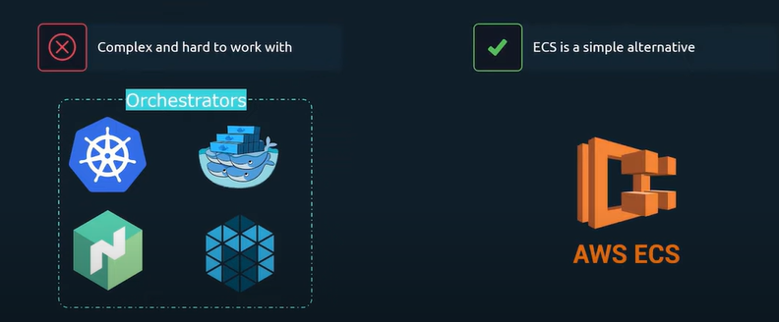
ECS VS Others

Slide 6
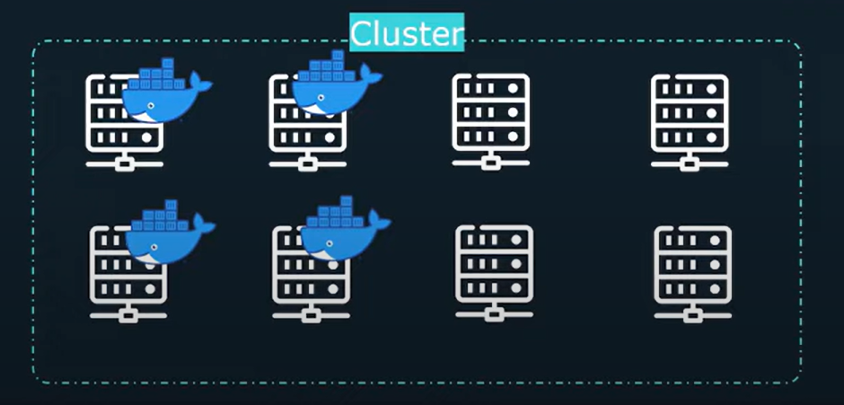
ECS
ECS has two lunch types
EC2 and Fargate

Slide 7
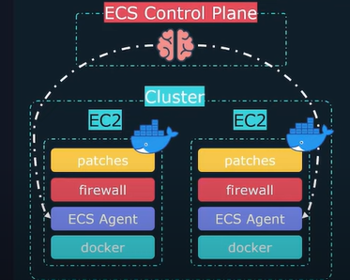
EC2 Type
EC2, we must manage the underlying EC2 instance
ECS managed the containers
Benefit is full control over the infrastructure

Slide 8
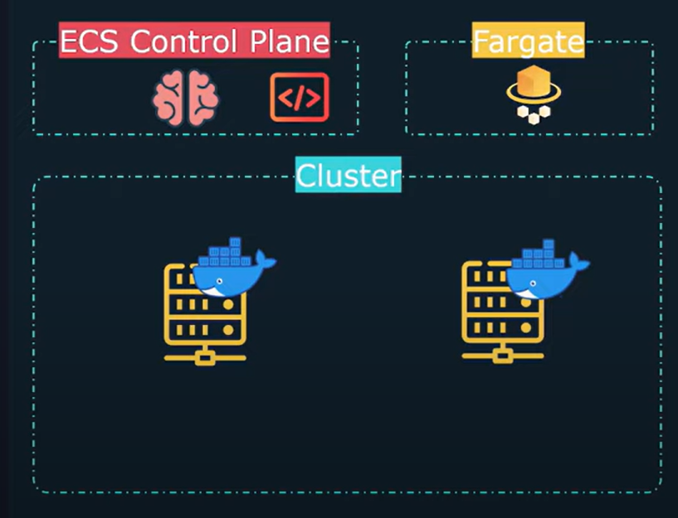
Fargate Type
Follows a serverless architecture
Fargate will create servers on demand
No need to provision/maintain EC2 servers

Slide 9
ECS components
ECS Task definition
ECS task
ECS services
Load balancers

Slide 10
ECS Task Definitions
Blueprint that describe how containers should lunch
How much CPU/MEM
Image/Ports/Volumes, etc.

Slide 11
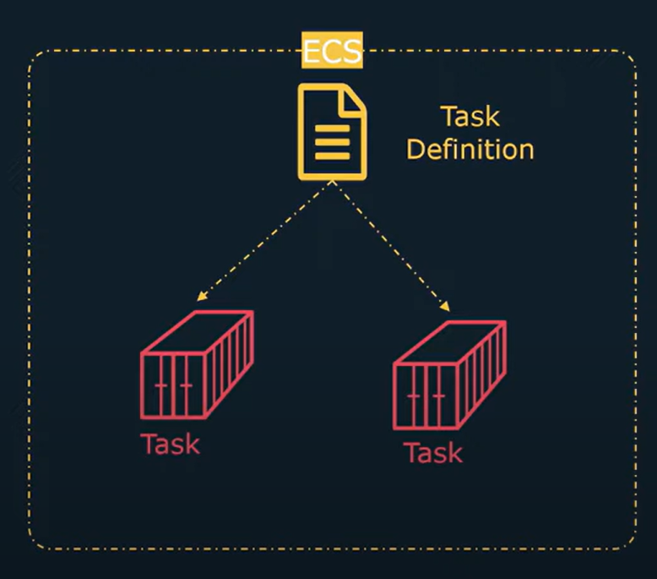
ECS Tasks
An instance of a task Definition
A running Containers with settings defined in the Task Def.

Slide 12
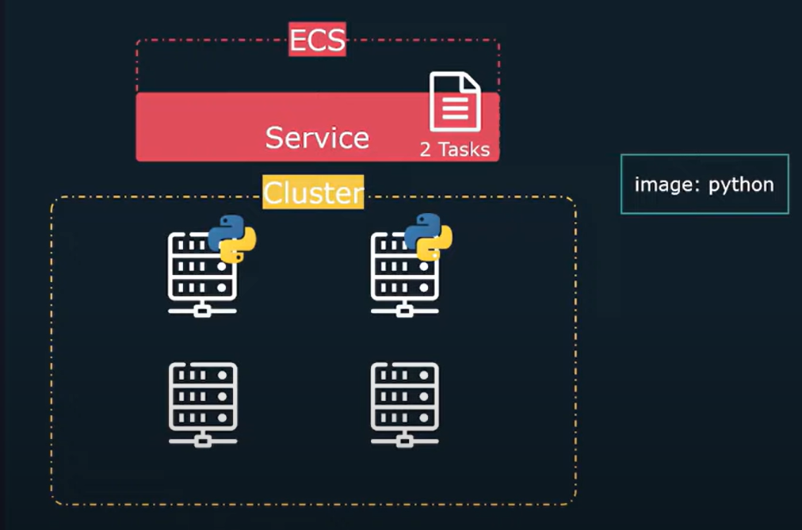
ECS Services
A service ensures that a certain number of tasks are always running
Restarts containers that have exited/crashed
EC2 instances fails, the service will restart task on a working EC2 instance

Slide 13
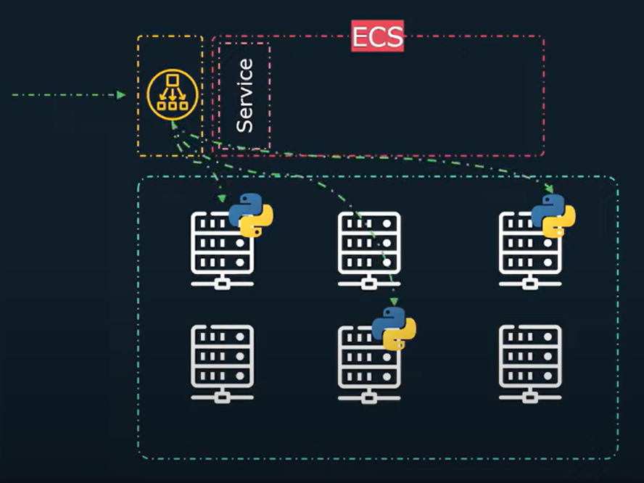
ECS and LoadBalancers
A load Balancer can be assigned to route external traffic to your service.

Slide 14
Thanks

